Slide 1
Sors Adversa
5
4
3
2
1
Boss Energy
Esempi barre vite

Slide 2
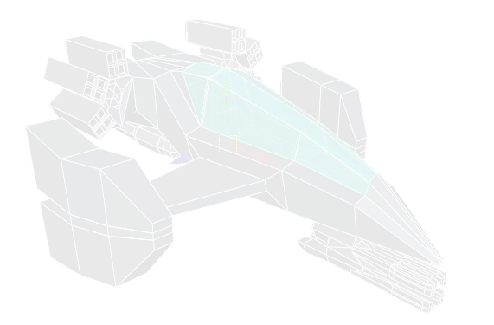
Sors Adversa
Player 1:
Player 2:
W
E
R
T
I
I
O
P
A
S
D
J
K
L
Options:
F4
Debug Mode
X
Camera shake
Esc
Exit
↑
C
Game Mode
←
→
Camera
V
GC Collect
↓

Slide 3


Sors Adversa
...the game experience will never be the same
Specs
Shots
Down
Help us
Credits
Developed with
#1 Scheduled contact: 18 February 2008
Sors Adversa - Copyright © 2008 DesdinovaTeam. All rights reserved.

Slide 4
new
new
Sors Adversa
options
options
exit
exit

Slide 5

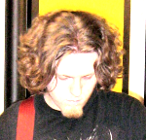

Slide 6
Sors Adversa
Player 1:
Player 2:
W
E
R
T
I
I
O
P
A
S
D
J
K
L
Press Enter to start
Developed with

Slide 7
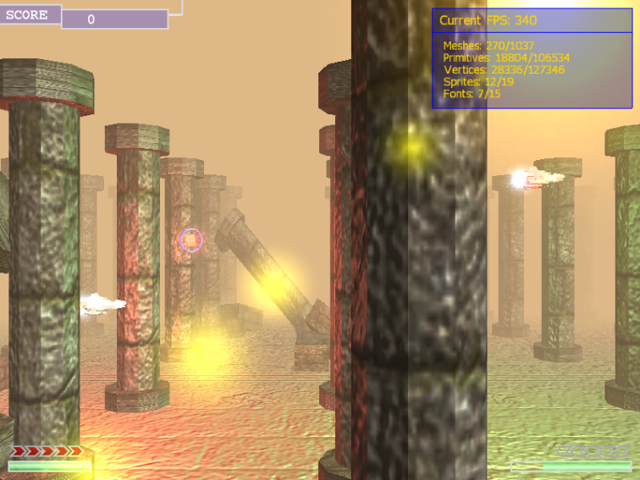
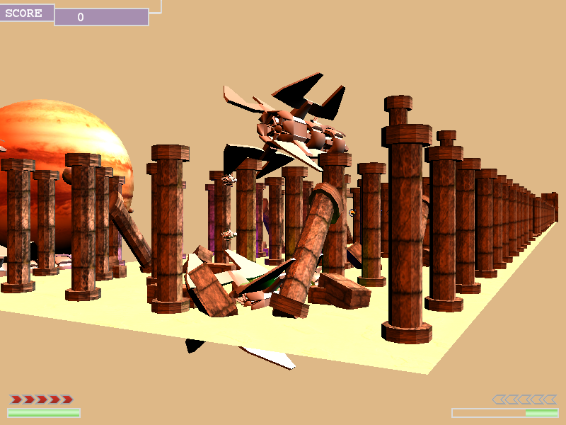
Desdinova Engine
COMING SOON...

Slide 8
L O A D I N G
Please wait...

Slide 9
SCORE
0018905
Boss Enemy Name

Slide 10
Highscore : 235000 Score: 185700
Boss Enemy Name

Slide 11
SCORE
0018905
Boss Enemy Name

Slide 12
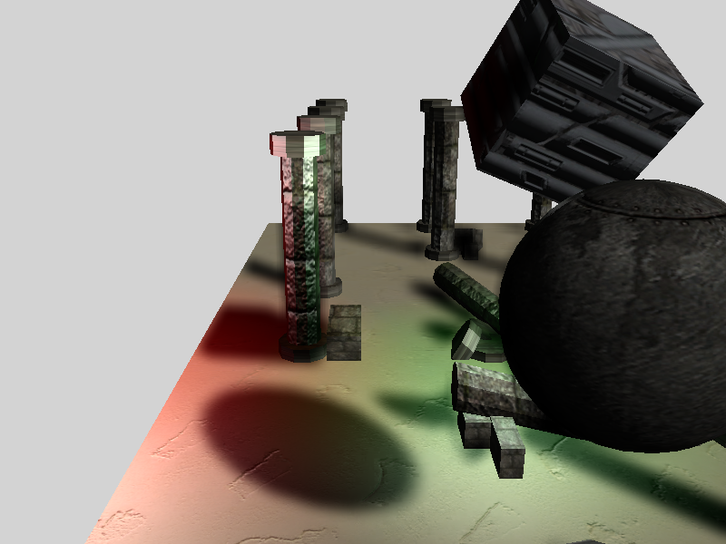
Desdinova
Engine

Slide 13

Sors Adversa

Slide 14
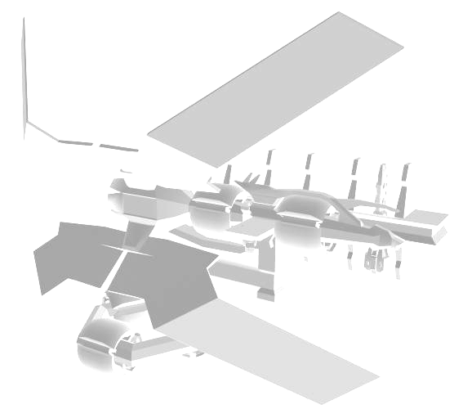
COMING SOON IN 2009
Sors Adversa
Welcome to a new era of shoot'em up
2.5D Gameplay Unique Game Sessions Advanced Weapons System 1 or 2 Cooperative Players ...and more great features

Slide 15
Sors Adversa

